Slide 1
Analytical instrumentation Section-2, Ppt-24

Slide 2
Gas chromatography
Gas chromatography is a separation technique in which the molecules are separated on the basis of their retention time depending on the affinity of the molecules to the stationary phase.

Slide 3
Principle of Gas chromatography
Gas chromatography is based on the principle that components having a higher affinity to the stationary phase have a higher retention time.
The mobile phase is a gas, mostly helium, that carries the sample through the column.
The sample once injected in converted into the vapor stage is then passed through a detector to determine the retention time.
The components are collected separately as they come out of the stationary phase at different times.

Slide 4
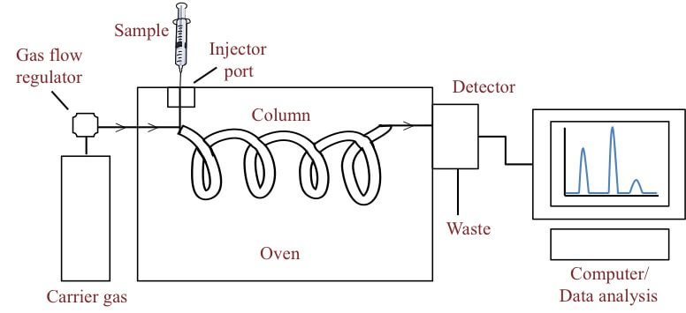

Slide 5
Steps of Gas chromatography
The sample is injected into the column where it is vaporized into a gaseous state. The vapourised component than mixes with the mobile phase to be carried through the rest of the column.
The column is set with the stationary phase where the molecules are separated on the basis of their affinity to the stationary phase.
The components of the mixture reach the detector at different times due to differences in the time they are retained in the column.

Slide 6
Uses of Gas chromatography
This technique is used to calculate the concentration of different chemicals in various samples.
This is used in the analysis of air pollutants, oil spills, and other samples.
Gas chromatography can also be used in forensic science to identify and quantify various biological samples found in the crime scene.

Slide 7
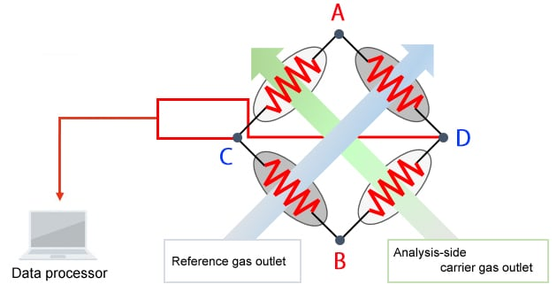
Thermal Conductivity Detectors (TCD)

Slide 8
High-performance liquid chromatography (HPLC)
Principle of HPLC
This technique is based on the principle of differential adsorption where different molecules in a mixture have a varying degree of interactions with the absorbent present on the stationary phase.
The molecules having higher affinity remain adsorbed for a longer time decreasing their speed of movement through the column.
However, the molecules with lower affinity move with a faster movement, thus allowing the molecules to be separated in different fractions.
This process is slightly different from the column chromatography as in this case; the solvent is forced under high pressures of up to 400 atmospheres instead of allowing it to drip down under gravity.

Slide 9
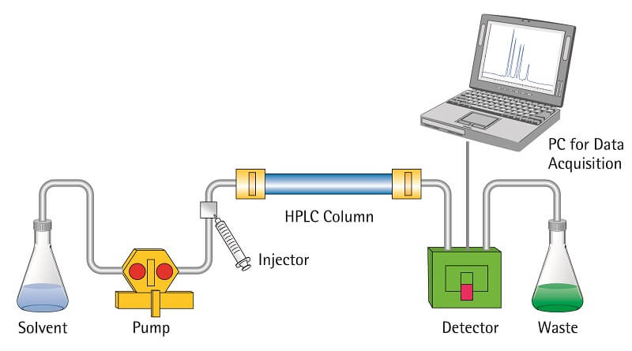
High-performance liquid chromatography (HPLC)

Slide 10
Steps of HPLC
The column is prepared by taking a glass tube that is dried and coated with a thin, uniform layer of stationary phase (cellulose, silica).
Then the sample is prepared by adding the mixture to the mobile phase. The sample is introduced into the column from the top, and a high-pressure pump is used to pass the sample at a constant rate.
The mobile phase then moves down to a detector that detects molecules at a certain absorbance wavelength.
The separated molecules can further be analyzed for various purposes.

Slide 11
Uses of HPLC
High-performance liquid chromatography is used in the analysis of pollutants present in environmental samples.
It is performed to maintain product purity and quality control of various industrial productions.
This technique can also be used to separate different biological molecules like proteins and nucleic acids.
The increased speed of this technique makes the process faster and more effective.

Slide 12
Liquid chromatography
Liquid chromatography is a separation technique where the mobile phase used is liquid, and the separation can take place either in a column or a plain surface.
(Pentane, cyclopentane, hexane, heptane or isooctane. Same, but with 10–20% of chloroform, dichloromethane tetrahydrofuran, acetonitrile, dioxane, etc.)

Slide 13
Principle of Liquid chromatography
The process of liquid chromatography is based on the principle for the affinity of the molecules to the mobile phase.
If the components to be separated have a higher affinity to the mobile phase, the molecules move along with the mobile phase and come out of the column faster.
However, if the components have a lower degree of interaction with the mobile phase, the molecules move slowly and thus come out of the column later.

Slide 14
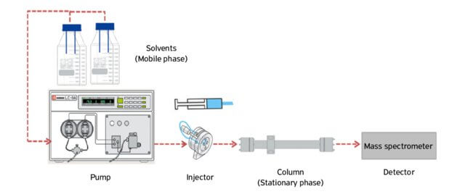

Slide 15
Steps of Liquid chromatography
The column or paper is prepared where the stationary phase (cellulose or silica) is applied on the solid support.
The sample is added to the liquid mobile phase, which is then injected into the chromatographic system.
The mobile phase moves through the stationary phase before coming out of the column or the edge of the paper.
An elution solution is applied to the system to separate the molecules from the stationary phase.

Slide 16
Uses of Liquid chromatography
Liquid chromatography is an effective method for the separation of a colored solution as they form two separate bands after separation.
This method can also be used over other techniques as it is quite simple and less expensive.
It can be used for the separation of solid molecules that are insoluble in water.

Slide 17
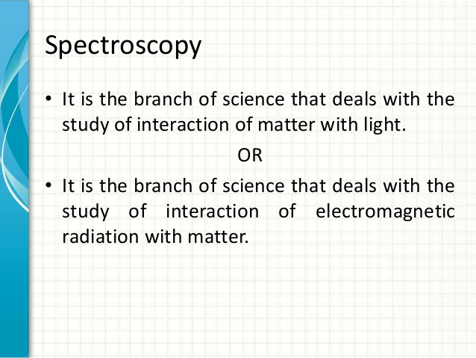

Slide 18
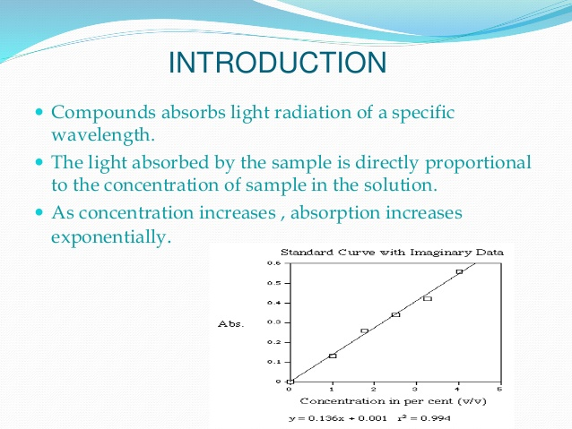

Slide 19
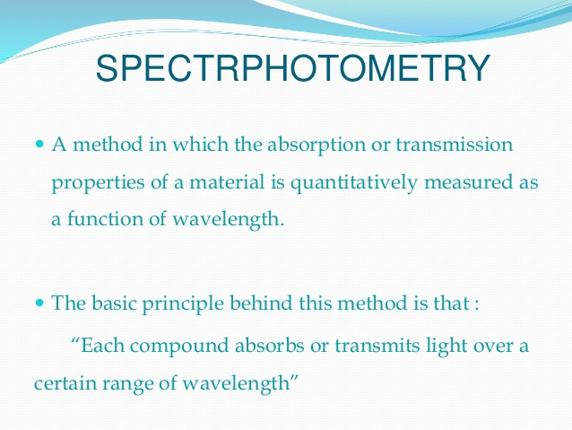

Slide 20
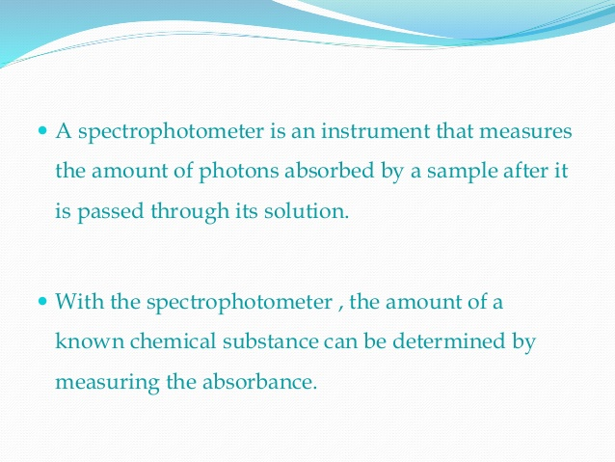

Slide 21
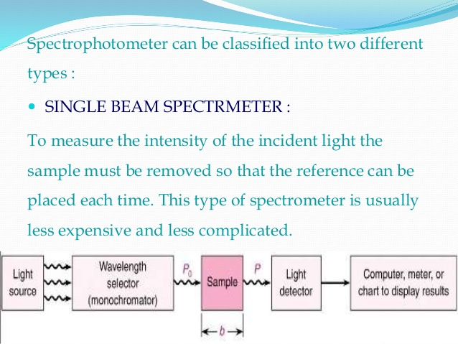

Slide 22
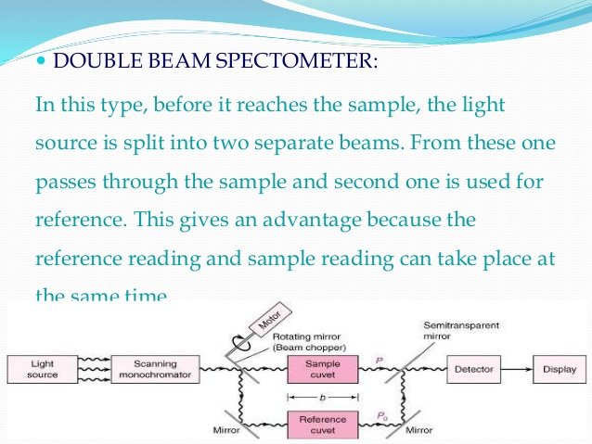

Slide 23
Chromatography
Chromatography’ is an analytical technique commonly used for separating a mixture of chemical substances into its individual components, so that the individual components can be thoroughly analyzed.

Slide 24
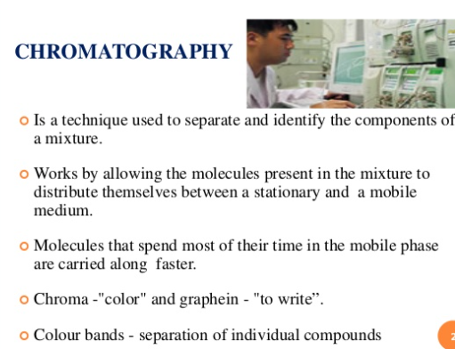

Slide 25
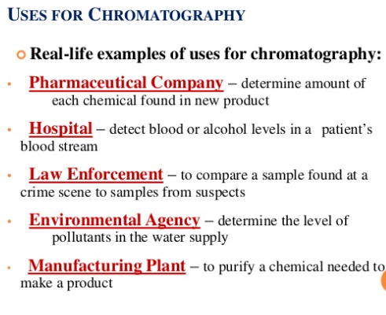

Slide 26
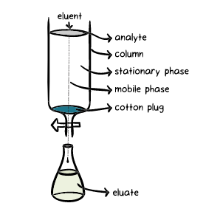
Mobile phase or carrier | solvent moving through the column
Stationary phase or adsorbent | substance that stays fixed inside the column
Eluent | fluid entering the column
Eluate | fluid exiting the column (that is collected in flasks)
Elution | the process of washing out a compound through a column using a suitable solvent
Analyte | mixture whose individual components have to be separated and analyzed

Slide 27
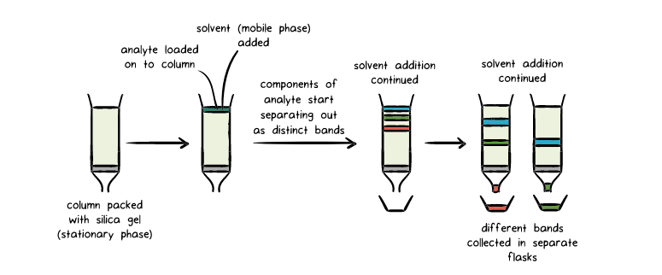

Slide 28
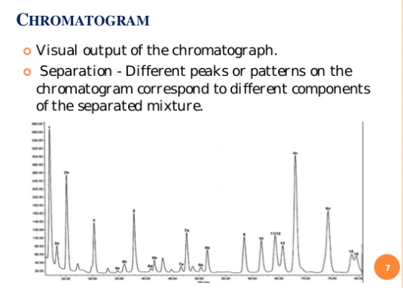

Slide 29
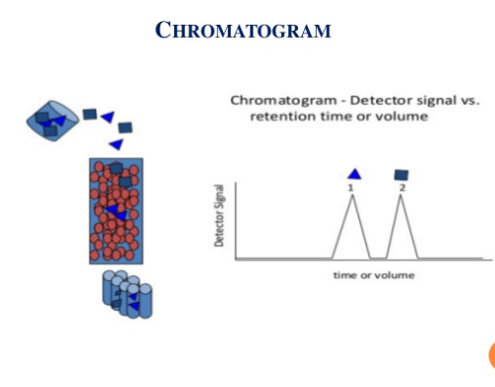

Slide 30
Here, silica acts as the stationary phase.
Solvent (mobile phase) is then made to flow through the silica bed (under gravity or pressure).
The different components of the analyte exhibit varying degrees of adhesion to the silica (see later), and as a result they travel at different speeds through the stationary phase as the solvent flows through it, indicated by the separation of the different bands.
The components that adhere more strongly to the stationary phase travel more slowly compared to those with a weaker adhesion.

Slide 31
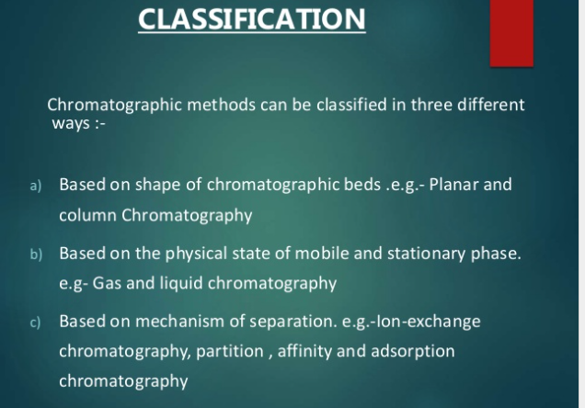

Slide 32
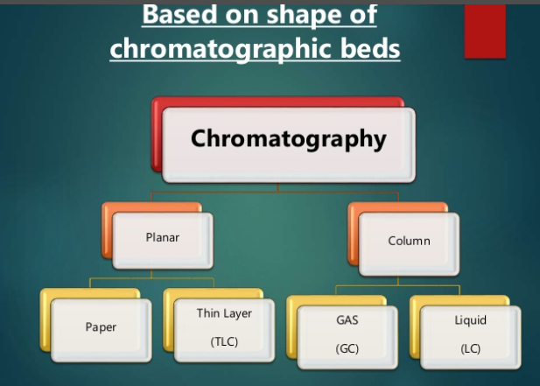

Slide 33
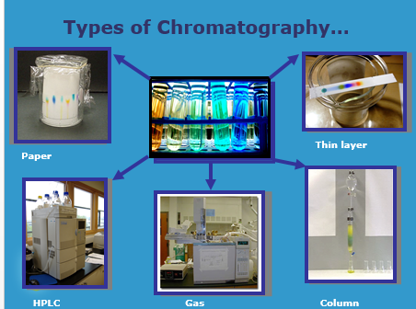

Slide 34
Thank you

